Slide 1
Nine Minimum Characteristics of a Disaster Resilient Community in Nepal
Krishna Kumar K.C.
Focal Point
CBDRM Coordination Mechanism
IFRC

Slide 2
Structure
Government
NRCS
Donors
Academics
INGOs / AIN
Flagship 4
Other interested parties
NGOs / CBOs
F1: School Safety
F1: Hospital Safety
F2: Emergency Prep & Response
F3: Flood Management Rivers
NRRC
F5: Policy & Institutional Support
Notes:
Led by MoFALD
Co-lead by International Federation of Red Cross and Red Crescent Societies (IFRC)
Overlaid by emergency response, now dealing with humanitarian agencies, cluster system, in addition to those working pre-earthquake.

Slide 3
Nepal Risk Reduction Consortium
National Strategy for Disaster Risk Management (2009). Key framework for DM activities in Nepal.
NRRC formed to address five derived priorities:
School and hospital safety (MoE, MoHP, ADB, UNICEF, WHO)
Emergency preparedness and response capacity (MoHA, IFRC)
Flood management in river basins (Ministry of Irrigation, World Bank)
Integrated Community Based Disaster Risk Reduction/Management(BDRR (MoFALD, IFRC)
Policy/institutional support for disaster risk management (MoHA, UNDP)
Notes:
In May 2009, the Government of Nepal (GoN) launched the Nepal Disaster Risk Reduction Consortium (NRRC). Under the leadership of the Government of Nepal, the NRRC brings together international financial institutions, Red Cross / Red Crescent Movement, NGOs, the United Nations system and development partners in an ambitious program to coordinate and fund disaster preparedness and risk reduction initiatives.
Different thematic areas under the consortium are led by different Ministries and supported by different agencies (i.e., Flagship 1 – School and Hospital Safety led by the Ministry of Education and Ministry of Health, supported by the Asian Development Bank, UNICEF, and World Health Organization; Flagship 2 – Emergency Preparedness and Response led by the Ministry of Home Affairs, supported by the International Federation of Red Cross and Red Crescent Societies; Flagship 3 – Flood Risk Management led by the Ministry of Irrigation, supported by the World Bank; Flagship 4 – Community Based Disaster Risk Reduction led by the Ministry of Federal Affairs and Local Development, supported by the International Federation of Red Cross and Red Crescent Societies; Flagship 5 – Policy/Institutional Support for Disaster Risk Management (DRM) led by the Ministry of Home Affairs, supported by UNDP.

Slide 4
Coordination Mechanisms
Nepal Risk Reduction Consortium
Steering Committee & Secretariat
Flagship 4 Advisory Committee
(Flagship 4 Coordinator)
Flagship 4 Consultation Group
Flagship 4 Web-Based Information Platform
Chair: Ministry of Home Affairs
Focal Ministries of the Government of Nepal
Official Consortium partners
Chair: Ministry of Federal Affairs and Local Development
Secretariat: IFRC
Members: INGO, Donors, Government, NRCS, DM coordination body
Open to all interested parties
Task Groups formed on technical issues as needed
Notes:
Flagship 4 coordination mechanism (see Figure 1)
Flagship 4 Coordinator
The Flagship 4 Coordinator will be appointed by the IFRC to provide both secretariat and technical support for Flagship 4 and ensure the timely flow of information to the various stakeholders.
Flagship 4 Advisory Committee
A small committee of representatives of the International Federation of Red Cross and Red Crescent Societies (IFRC), Nepal Red Cross Society, Ministry of Local Development (MoFALD), UN, NGOs and donors will act as the decision-making body for Flagship 4, co-chaired by the IFRC and MoFALD. The Committee will meet on a regular basis to oversee the development and implementation of the Flagship 4 Joint Programme Results and the Co-Chairs will participate in meetings of the overall Consortium coordination mechanism. Specific Terms of Reference have been developed.
Flagship 4 Consultation Group
A Flagship 4 Consultation Group will comprise representatives of all the key stakeholders involved in the implementation and funding of CBDRR activities in Nepal. The group will meet on a regular basis to discuss and make recommendations to the Flagship 4 Committee on the development and implementation of the Flagship 4 Joint Programme Results and exchange information on the progress of Flagship 4 Joint Programme Results.
Information Platform for Flagship 4
A web-based information platform for Flagship 4 activities will be established and maintained throughout the project implementation period as a mechanism for dissemination, information exchange, resource collection and progress monitoring. A concept note containing further details will be developed in due course.
Task Groups
Several task groups formed by implementing partners to address key topics (e.g., Urban DRR/M, 9 Minimum Characteristics, project tracking)
Request that those who were formally part of the Task Groups indicate if they want to continue to engage in that TG.

Slide 5
9 Minimum Characteristics of a Resilient Community

Slide 6
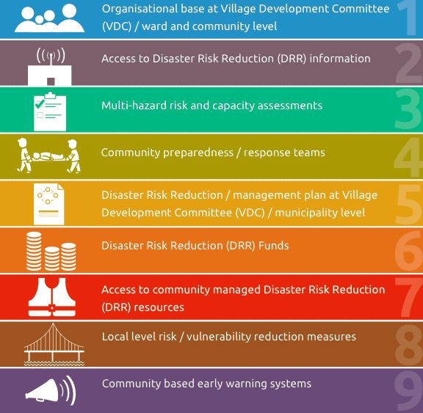
9 Minimum Characteristics
Notes:
Acknowledge all the joint efforts to prepare 9 MCs, hard work, has been held up as an example of the positive effects of collaboration.
Resources:
Marketing materials: 9 MC handout, one-pagers on Flagships, Flagship 4 Handbook (includes sample indicators, and output indicators)
Need to know what we can do better, what has worked, and the extent to which they have been used in projects.

Slide 7
1. Organisational base at rural/municipality / ward and community level
A functional organizational base at rural/ municipality/ ward and community level for the implementation and sustainability of disaster risk reduction (DRR), which addresses the issues of protection, social inclusion (including gender balance), community ownership and participation and follows DRR initiatives.

Slide 8
2. Access to Disaster Risk Reduction (DRR) information
Coordination mechanisms and partnerships to enable access to DRR information involving local, district and national level government structures, civil society organizations, private sector and vulnerable groups, including linkages with key institutions such as schools and hospitals.

Slide 9
3. Multi-hazard risk and capacity assessments
Ongoing, systematic, participatory, multi-hazard risk and capacity assessments which enable the monitoring and evaluation of DRR at municipality and community level and which link into district and national monitoring and evaluation systems.

Slide 10
4. Community preparedness / response teams
This involves community teams that are trained and equipped to provide hazard warning and evacuation information, light search and rescue and basic first aid.
Notes:
Dates: Posting ASAP, aiming to have completed by end of November/early December.
Please confirm if you were originally on the 9 MC Task Group and will still continue your role.
Update existing tools: e.g., Flagship 4 handbook, IEC materials
Finalize: Robust set of indicators (outcome / output / impact), checklist of Criteria for Proposals (with donors), training packages, establish baseline, monitor & evaluate system
Will require time of all flagship 4 implementing partners, participation and availability crucial.

Slide 11
5. Disaster Risk Reduction / Management plan at Village Development Committee / municipality level
A plan at the local level which meets the Flagship 4 minimum requirements listed and is regularly updated, implemented and tested.

Slide 12
7. Access to community-managed resources
Access to community-managed resources such as human and materials at municipality/ ward levels for DRR initiatives.

Slide 13
6. Disaster Risk Reduction (DRR) Funds
Funds accessible to communities for priority disaster risk reduction activities which are available at municipality / ward level and/or through community resource mobilization efforts.

Slide 14
8. Local level risk / vulnerability reduction measures
Municipality / ward level initiatives on identification, prioritization and application of local level risk / vulnerability reduction measures.

Slide 15
9. Community based early warning systems
Inclusive, community based early warning systems that are integrated with municipality / ward, district, regional and national early warning systems.

Slide 16
QUESTIONS

Slide 17
THNAK YOU

